Slide 1
A Fare way to go
Barriers faced by the residents of Clackmannanshire who rely on public transport to attend Hospital
Lynne Brierley
Clackmannanshire Citizens Advice
August 2016

Slide 2
Introduction
This presentation aims to give an overview of the challenges faced by residents in Clackmannanshire when attending Hospital appointments by public transport.
It will focus on the -
Cost and time to attend
Availability of alternative patient transport
Public transport options available

Slide 3
Clackmannanshire
The 2015 population for Clackmannanshire is 51,360
Accounts for 1.0 per cent of the total population of Scotland
Over a 25 year period the number of -
lone adult households is projected to increase by 47 %
larger households in Clackmannanshire is projected to fall
Households of 2 or more adults with children decreasing by 37 per cent over the 25 year period
Source - National Records of Scotland

Slide 4
Round the bend - Key points
Median travel time: 57 minutes
Average distance: 14 miles
Median cost: £3.40
Median pence per mile: 24p

Slide 5
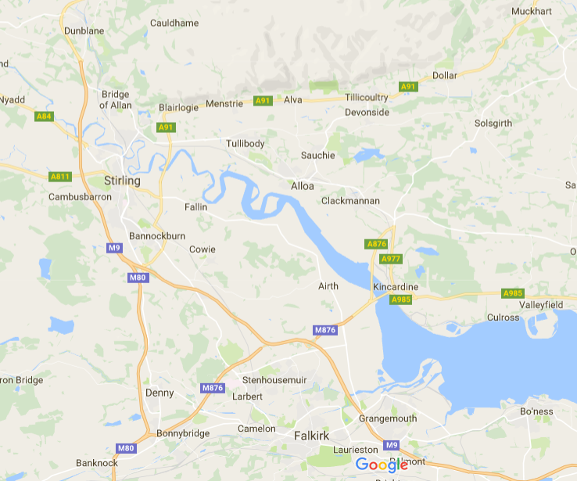
Distance
Dollar 16 miles
Muckhart 20 miles
From Alva 15 miles
Tullibody 12 miles

Slide 6
Public Transport policy
The Forth Valley Transport Hub Operating Procedure state that –
Subject to the specific health needs as detailed by clinical assessment, transport must be
considered in the order outlined below:
1 Patient’s own transport, relatives etc. This is always the preferred option.
2 Appropriate public transport options
3 T-Hub Subject to Patient Needs Assessment (PNA) criteria

Slide 7
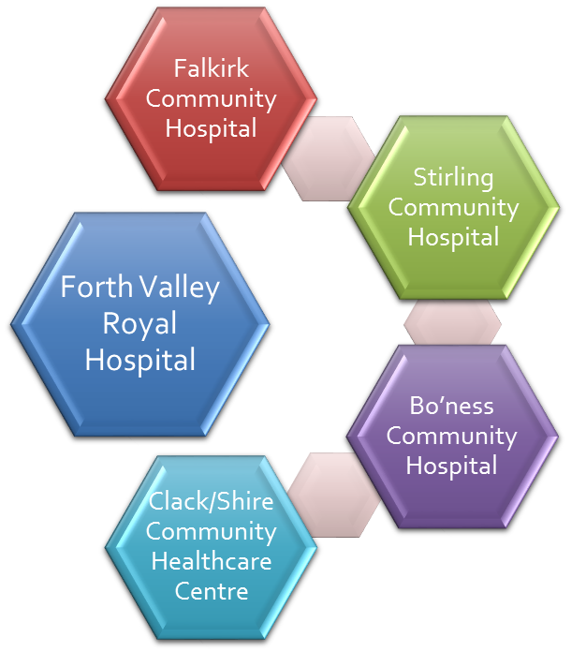
Patient transport
Scottish Ambulance Service
Red Cross Transport and Escort Service
RVS Community Transport and Good Neighbour Service (Stirling Area – Over 60s)
Order of Malta / Dial a Journey
The Driving Force will take anyone who has cancer and is registered with a GP in Bonnybridge, Denny or Banknock to hospital appointments free of charge

Slide 8
Public transport SERVICES
60* | H1 Hillfoots | H2 Hillfoots | 62/63
Clackmannan – Alloa – Tullibody – Forth Valley Royal Hospital | Alva - Menstrie - Tullibody - Alloa - Clackmannan - Forth Valley Royal Hospital | Dollar - Tillicoultry - Alloa - Clackmannan - Forth Valley Royal Hospital | Menstrie – Alva – Tillicoultry –Alloa
Every hour - Direct | Every 2 hours - Direct | Every 2 hours - Direct | Every 20 mins – Change at Alloa
1 hour 26 mins | 51 mins | 52 mins | 37 mins
Last bus from Hospital 20:06 | Last bus from Hospital 19:34 | Last bus from Hospital 22:32 (H1 route passengers changing at Alloa) | Last bus from Alloa 23.57 (hourly after 20:00)
No 60 leaves Alloa 51 mins the hour H1/H2 leaves Alloa 55 mins past the hour

Slide 9
Journey - Example
Outward Journey from Tillicoultry 10am appointment | Return Journey from Forth Valley Hospital Larbert
Depart - 8am Arrive - 9.35am | Depart - 11am Arrive - 12.52am
1hr 36 mins | 1hr 52 mins
Cost –£3.90 Single fare Return fare between £4.40/£5.00

Slide 10
Additional information
The H1/2 bus service only funded until March 2018
The N60 bus has recently been threatened with a reduction in service and route
Buses leave Alloa to Forth Valley Hospital every 51 mins and every 55 minutes
No Sunday Services
Bus Fares can range from £4.40 to £7.90 with no flat rate offered in the Clackmannanshire Council area irrespective of location.

Slide 11
Impact
Bus services are every 2 hours in areas classed as “rural” such as the Hillfoots : - these will not always tie in with appointments leading to a longer waiting time.
Buses leave Alloa every 51 and 55 minutes past the hour : - this is likely to increase the waiting times for passengers that have to make a connection.
Evening services are reduced : - this will increase the difficulty of family and friends being able to visit hospital in-patients.

Slide 12
Summary
Residents of Clackmannanshire that rely on public transport to travel to Forth Valley Hospital face the prospect of a long journey , extensive waiting times, that essentially could turn a 30 minute appointment into a day long trip.
The location of the hospital can’t be changed therefore it is essential that:
Access to public transport continues to be maintained for those that use it.
Alternative Bus routes and Operators to ensure value for money.
Consultation should continue between Bus Operators, NHS, the Public and Clackmannanshire council
Bus Operators should consider the times that other routes depart to avoid overlapping services.

